Slide 1

Resource Allocation and
Deadlock Detection System
Submitted to:-
Dr. Shashi Kant Gupta
Professor Dept. Of CSE
School of Engineering and Technology
Submitted by:-
Abhi Yadav (BCAN1CA24002)
Aditya Sharma (BCAN1CA24013)
Anirudh Kushwah (BCAN1CA24023)

Slide 2
Introduction
What is deadlock? A deadlock occurs when a group of processes wait indefinitely for resources held by each other. This project aims to monitor and manage system resources efficiently to avoid such deadlocks.
How It Works?
The system models processes and resources as input.
Uses Banker's Algorithm to check if a state is safe before resource allocation.
Monitors resource requests and allocations in real time.
If a cycle is found in the RAG, a deadlock is detected.

Slide 3
Objective
The objective of this project is to implement an interactive
user-friendly system or program which allows the user to input the number of processes and resources in their computer system and check if the system would detect a deadlock or not by using the Banker’s algorithm for deadlock detection and generation of the safety sequence.

Slide 4
Methodology
Implementation of Banker’s Algorithm
The user is asked to input the number of processes and resources they have and the maximum resources needed by each process
Calculation of Available resources and Need Matrix :
By using different loops, the program calculates the need matrix and also the available resources in the system.
Deadlock Detection :
Based on those matrices the system then checks if a deadlock is detected or not in the program :
if yes, then it returns an error message
if no, the program is executed without any errors and safety sequence is generated.

Slide 5
SIGNIFICANCE OF PBL
The implementation of this project is helpful for students to get a better understanding of the calculations and methods done to detect a deadlock using banker’s algorithm.
Helps the user to check if a deadlock is occurring in the system or not, and if so, then indicate the user about it.
Generates a safety sequence to let the user know in which order the processes are to be executed.

Slide 6
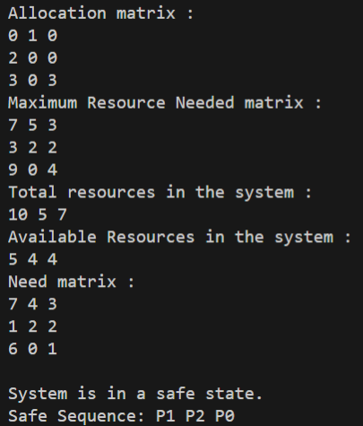
OUTCOME OF THE PBL
The outcome is of a basic situation where 3 process are currently running and 3 different resources are allocated to each and every process.
1. When system is in “Safe State” :

Slide 7
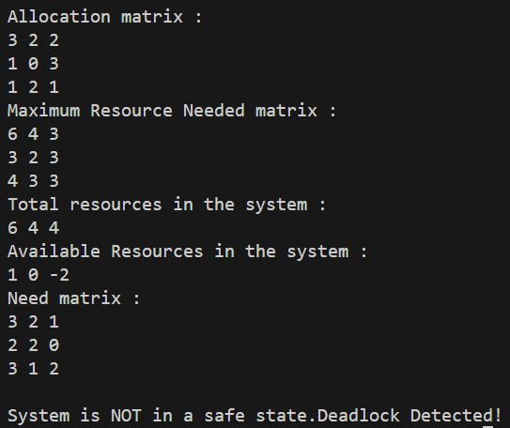
OUTCOME OF THE PBL
2. When system is in “Un-Safe State” :

Slide 8
Conclusion :
This project successfully implements the Banker's Algorithm to detect whether a system is in a safe or unsafe state based on resource allocation.
By calculating the need and available resources, the program evaluates whether all processes can complete without causing a deadlock.
It demonstrates the importance of resource management and safety checks in operating systems.
The output not only identifies the system state but also provides a valid safe sequence.

Slide 9
Future Scope :
Multiple users at the same time :
Multi user functionality to be added, currently this project can be accessed by one user at a time.
Graphical User Interface :
Add a user-friendly GUI for better visualization of processes, resources, and safe sequences.
Rollback mechanism :
Implement rollback to handle unsafe states and prevent system crashes.

Slide 10
References :
Abraham Silberschatz, Peter B. Galvin, Greg Gagne – Operating System Concepts, 9th Edition – Wiley.
Geeks For Geeks
TutorialPoints
Lecture Notes

Slide 11


